Slide 1



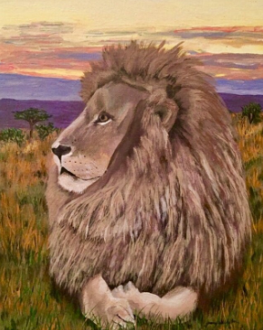
Be Strong

Slide 2

What Does the Bible Say?

Slide 3



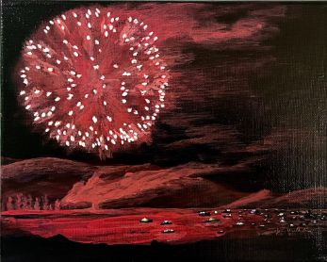
Do Not Fear

Slide 4



Slide 5



Trust that God is With You

Slide 6

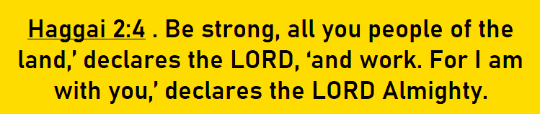

Slide 7

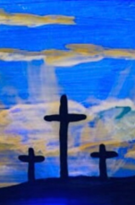

Follow Jesus

Slide 8
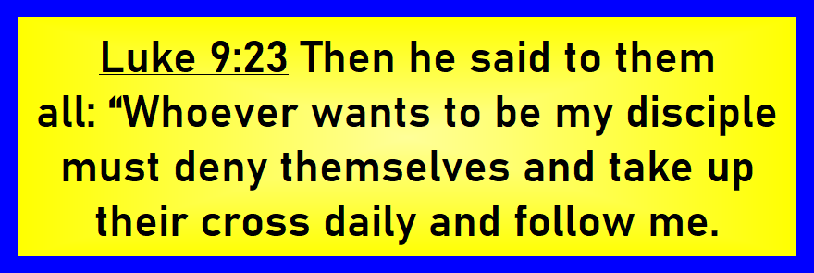
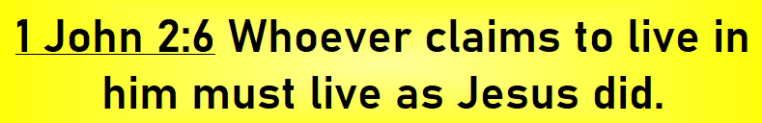
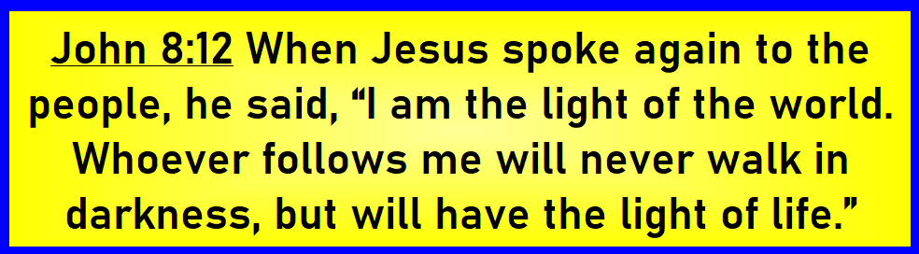

Slide 9

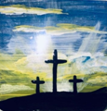
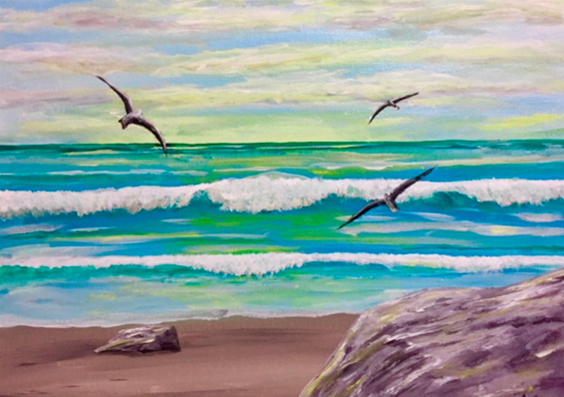


Let Jesus Give
You Strength

Slide 10

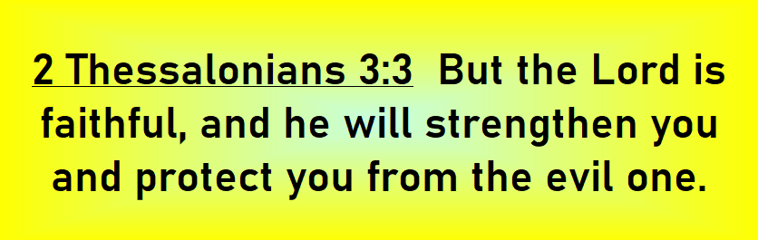

Slide 11


Summary
Do Not Fear
Be Strong
Let Jesus Give You Strength
Trust God is With You
Follow Jesus

