Slide 1
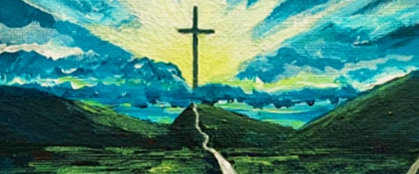

Salvation
Are you sure you’re saved?

Slide 2
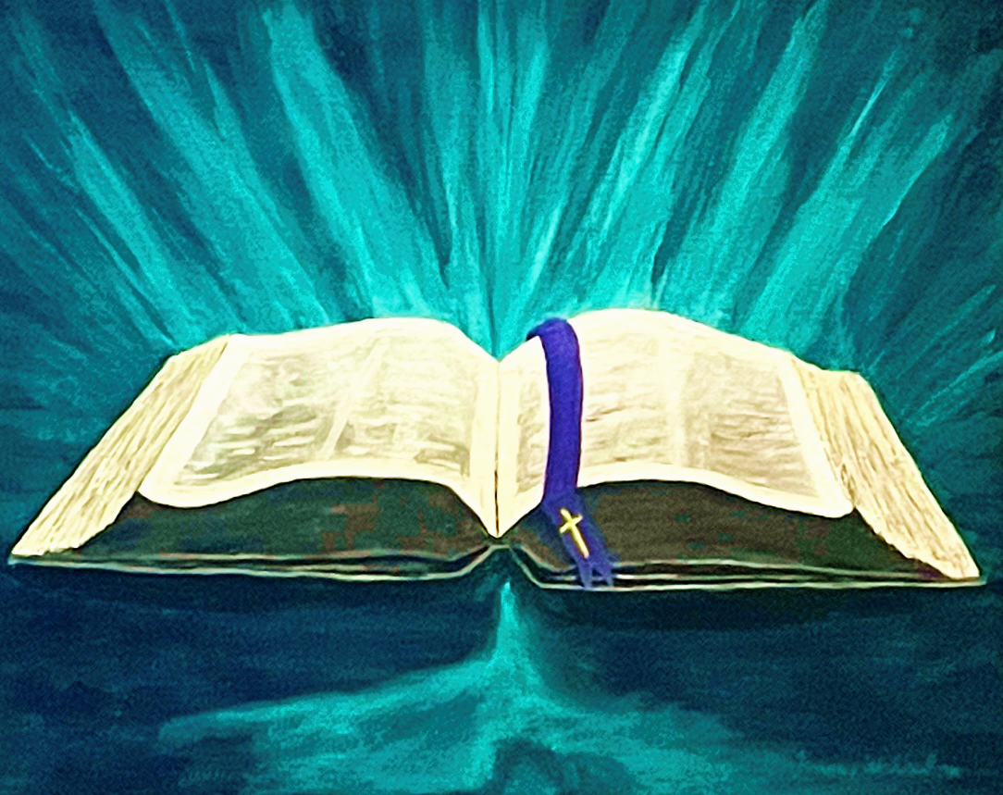
What Does the Bible Say?

Slide 3
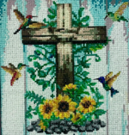
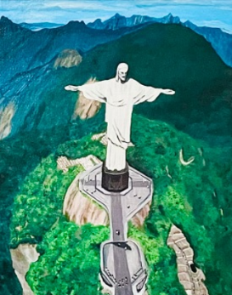
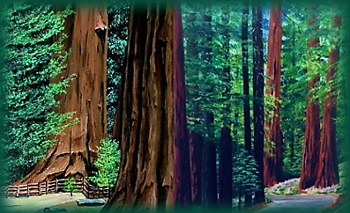
Do You Believe?

Slide 4



Slide 5

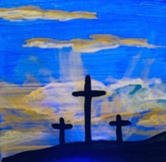
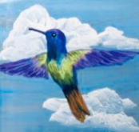
Does Jesus Live in Your Heart?
Is Your Body His Temple?

Slide 6



Slide 7
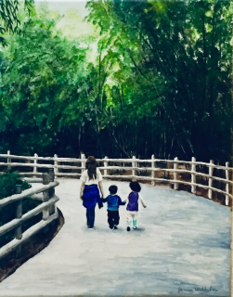



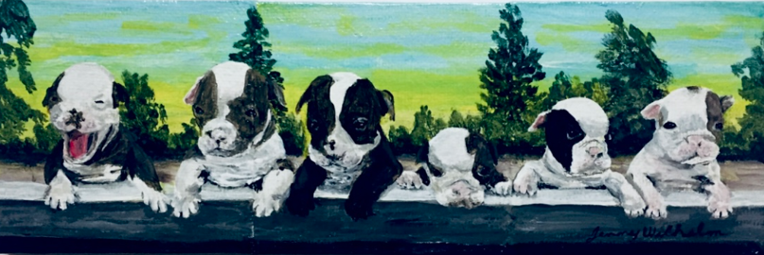
Are You Born Again?
Is He Your Father?
?

Slide 8




Slide 9


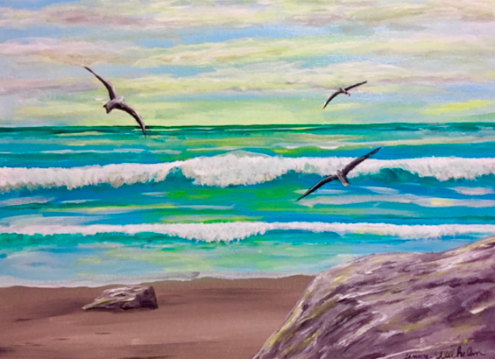
Does Jesus Know You?
Do You Know Jesus?

Slide 10




Slide 11
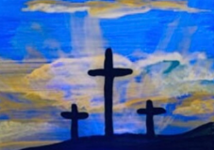
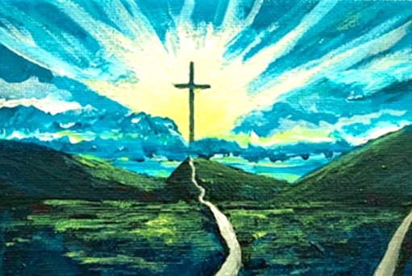


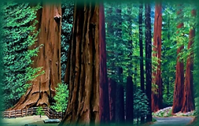
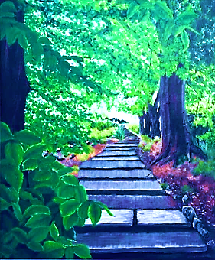
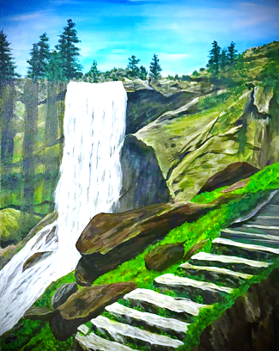
Summary
You Believe.
Jesus Lives In Your Heart
You are Born Again.
Your Body is God’s Temple.
Jesus Knows You.
You Know Jesus.
You Are Saved.

