Slide 1
Forgiving
How Can We Forgive?

Slide 2

What Does the Bible Say?

Slide 3

If You Don’t Forgive Others,
God Won’t Forgive You

Slide 4
Matthew 6:14-15 For if you forgive other people when they sin against you, your heavenly Father will also forgive you. But if you do not forgive others their sins, your Father will not forgive your sins.
Matthew 18:21-35 Then Peter came to Jesus and asked, “Lord, how many times shall I forgive my brother or sister who sins against me? Up to seven times?” Jesus answered, “I tell you, not seven times, but seventy-seven times.

Slide 5

Don’t Look Back
Move Forward

Slide 6
Philippians 3:13-14 Brothers and sisters, I do not consider myself yet to have taken hold of it. But one thing I do: Forgetting what is behind and straining toward what is ahead, I press on toward the goal to win the prize for which God has called me heavenward in Christ Jesus.
Isaiah 43:18-19 “Forget the former things; do not dwell on the past. See, I am doing a new thing! Now it springs up; do you not perceive it? I am making a way in the wilderness and streams in the wasteland.

Slide 7

God’s Will, Not Yours

Slide 8
Hebrews 12:2 fixing our eyes on Jesus, the pioneer and perfecter of faith.
Colossians 3:2 Set your minds on things above, not on earthly things.
Hebrews 12:2 fixing our eyes on Jesus, the pioneer and perfecter of faith.
Colossians 3:2 Set your minds on things above, not on earthly things.

Slide 9
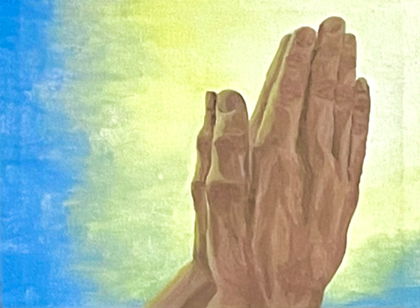
Pray for Our Enemies
Pray for Your Enemies

Slide 10
Matthew 5:43-44 (Jesus said) “You have heard that it was said, ‘Love your neighbor and hate your enemy.’ But I tell you, love your enemies and pray for those who persecute you.”
Luke 6:27-29 (Jesus said) “But to you who are listening I say: Love your enemies, do good to those who hate you, bless those who curse you, pray for those who mistreat you.”

Slide 11


Summary
Ask God to forgive you your sins and to help you forgive others.
Don’t dwell in the past, move forward.
Keep your eyes on Jesus.
Live for God’s will, not your own.
Read the Bible. Ask God to speak to you through it.
Pray for your enemies. God may reveal something important to help you forgive.
Jenaministries.com

