Slide 1





God’s Will for You

Slide 2

What Does the Bible Say?

Slide 3
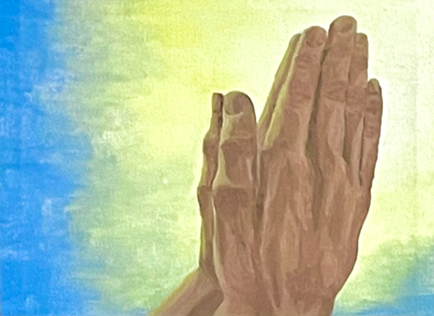


Pray for Wisdom

Slide 4
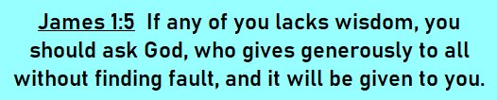
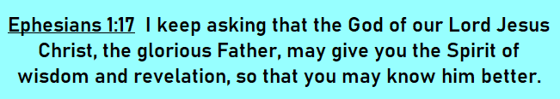

Slide 5





Do Not Conform to This World

Slide 6
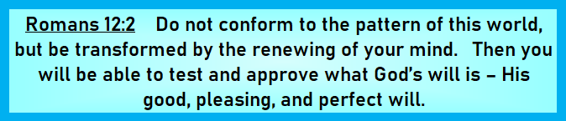
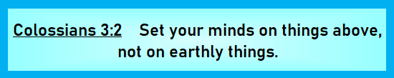

Slide 7



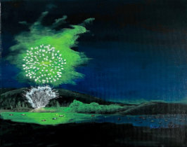
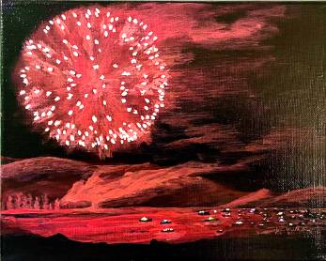

Be Thankful in Everything
Pray Continually
Always Rejoice

Slide 8


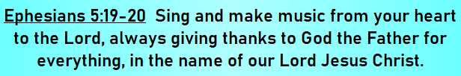

Slide 9





Live in the Peace of God

Slide 10
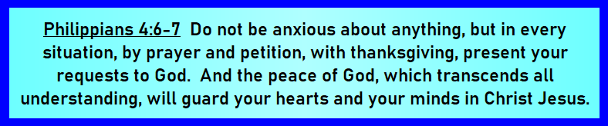
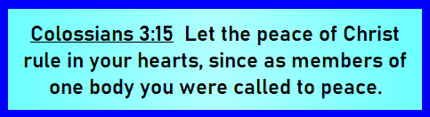

Slide 11


Summary
Pray for Wisdom
Do Not Conform to This World
Be Thankful in Everything
Pray Continually
Always Rejoice
Live in the Peace of God
God’s Will
for You

